Slide 1
Splunk for Data Science
By: Santosh Cheruku

Slide 2

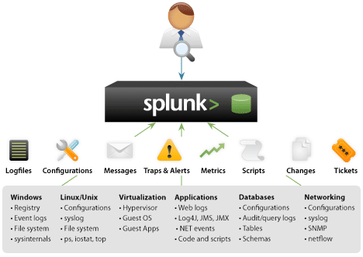
Collect data from multiple sources
1. App log files
2. Query logs
3. Network logs
4. Config logs
5. Many more

Slide 3
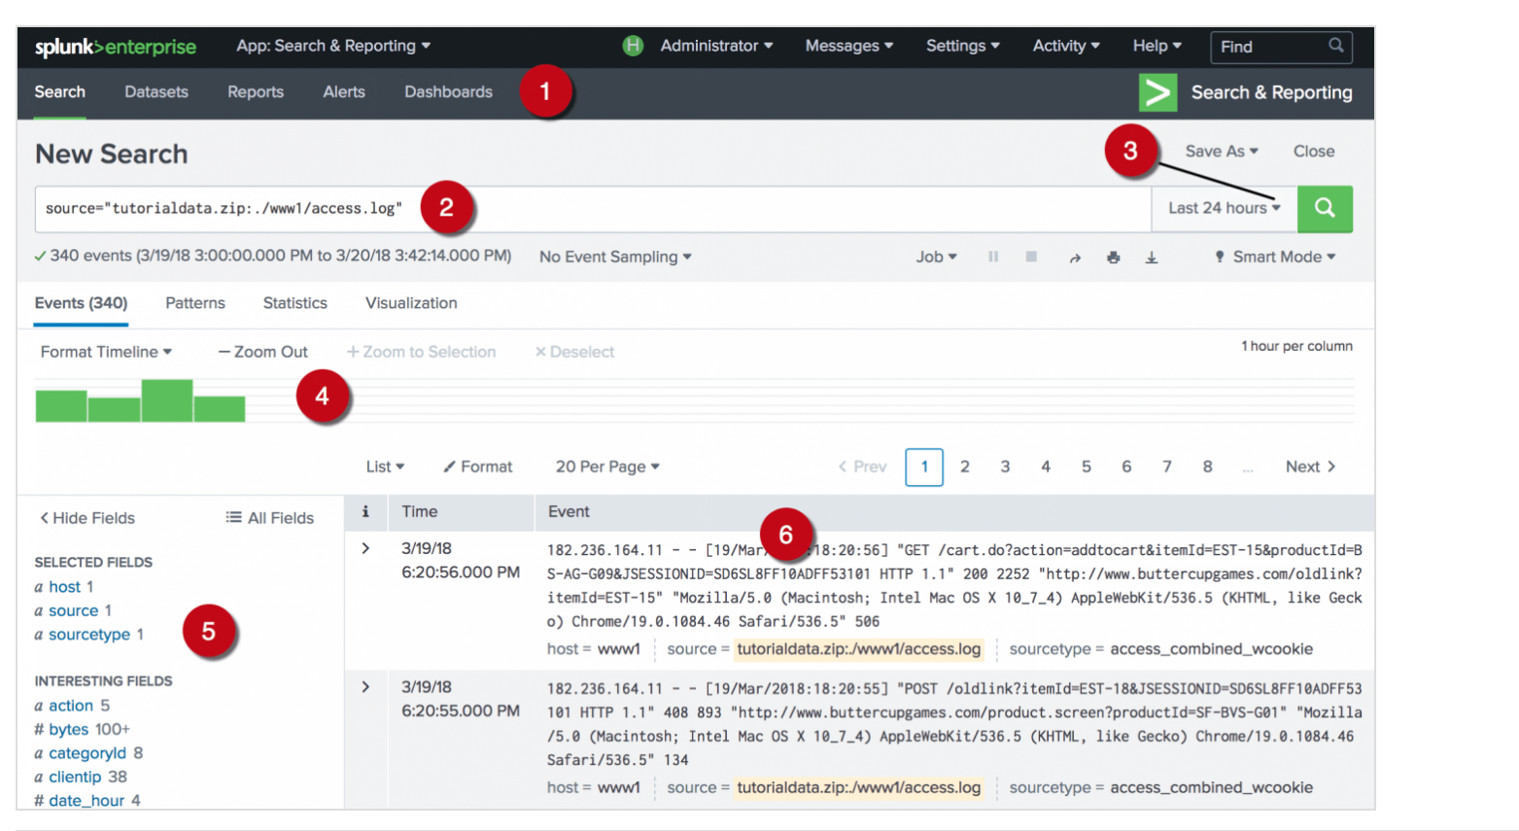
Data search
1. Apps bar
2. Search bar
3. Time range
4. Timeline
5. Field picker
6. Data

Slide 4
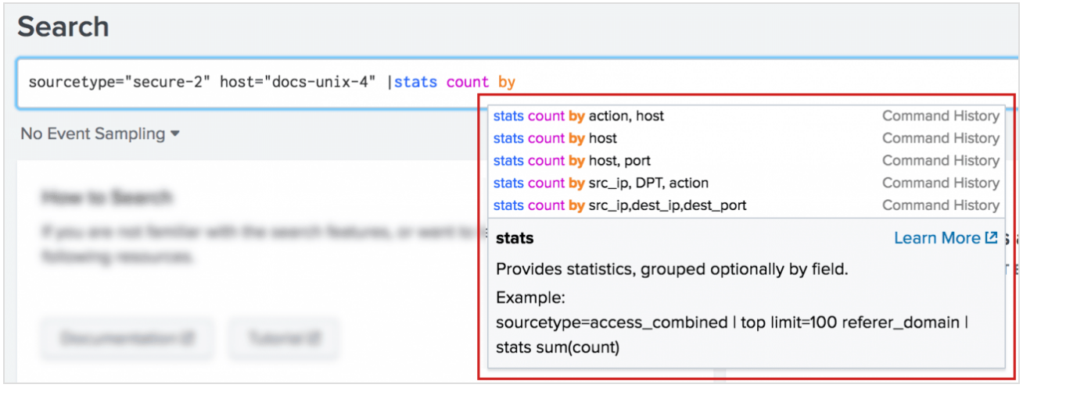
Splunk: Search Processing Language(SPL)
Allow searching the data sources by running commands written according to SPL specific to Splunk.
Allows creating custom variables with in queries
Supports concatenating multiple commands using piping option
Allows to combine regular search queries and aggregation commands such as top, stats, max, min etc
Supports generating timecharts, pie charts, bar charts etc

Slide 5
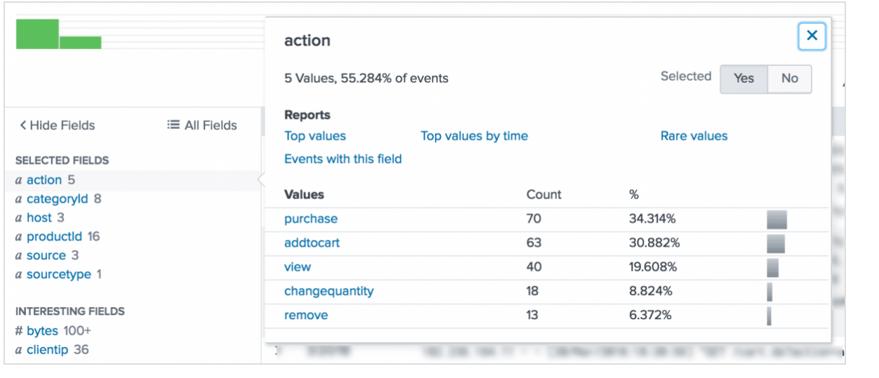
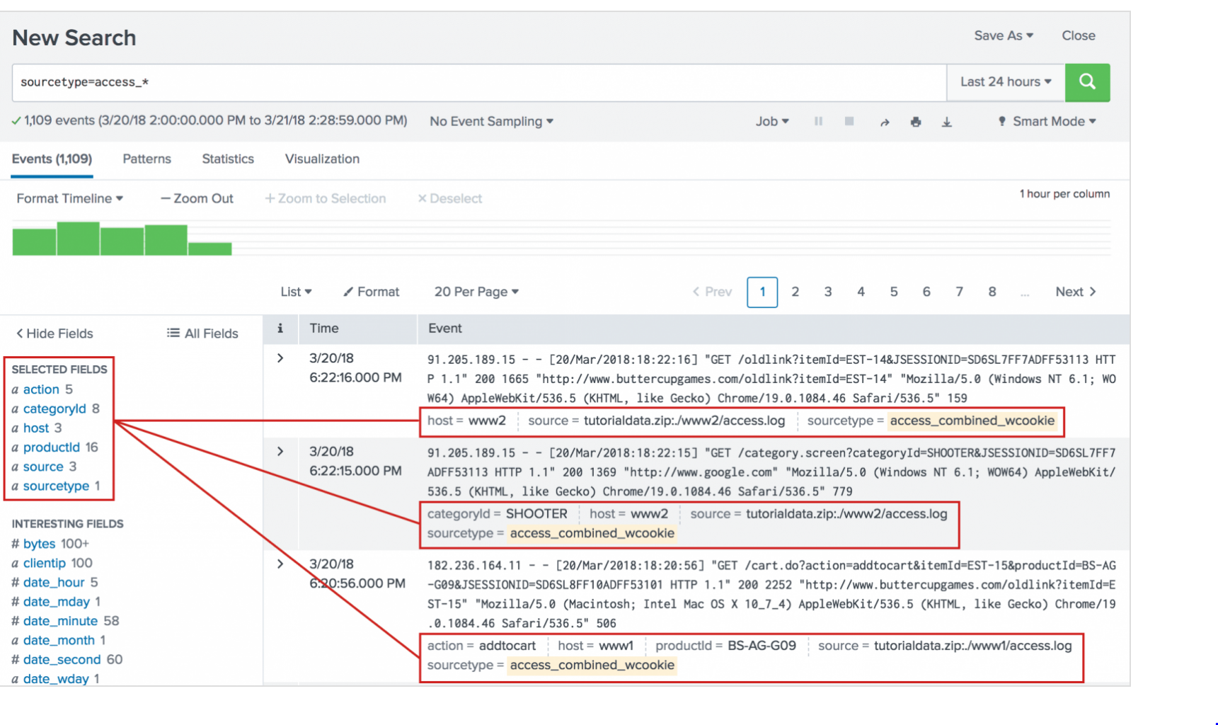
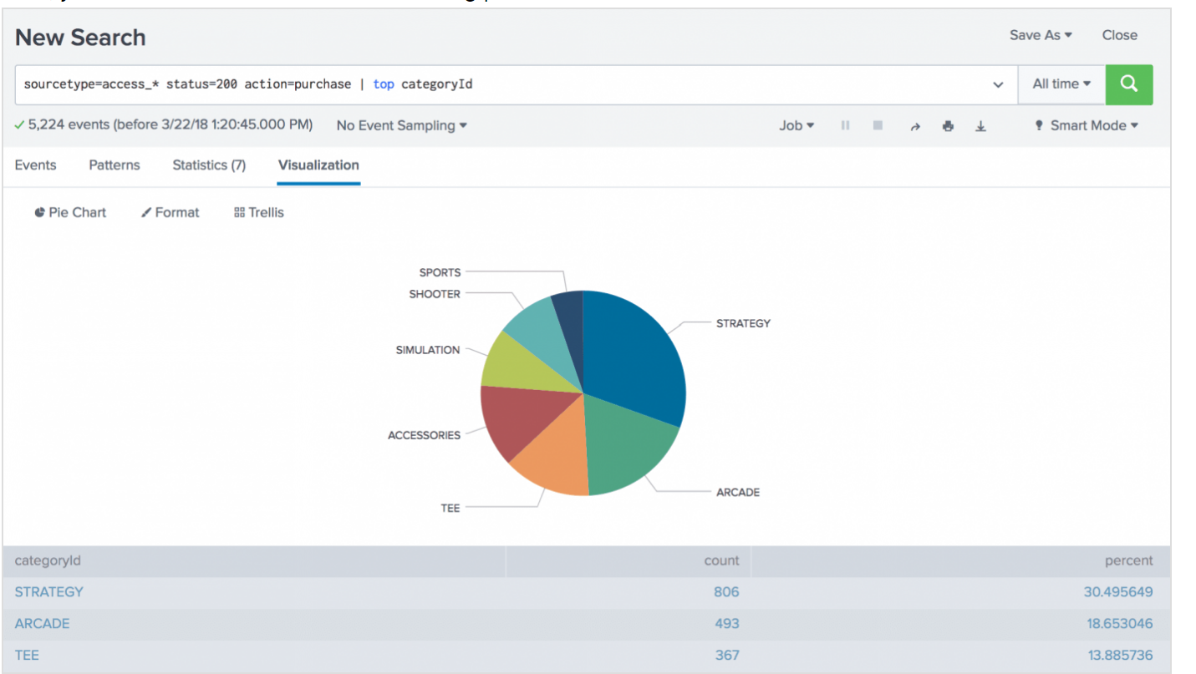
Search Results

Slide 6
Splunk for Data Science
It’s much useful for running analytics on near real time data
Useful for generating quick stats by running SPL queries against huge datasets from multiple data sources
Pretty good at identifying trends and issues at real time
Configure alerts or notifications on real time situations
Chart and visualize statistics
Machine learning and anomaly detection

Slide 7
Using R in Splunk
Programs using other technologies such as R, Python can be integrated into Splunk (SPL).

Slide 8
Pros and Cons
Pros:
Tool that is currently one of the leaders in Data Analytics
Can handle wide variety of data sources
Wide variety of use cases such as Analytics, Threat monitoring, Alerts, Pattern detection
Cons:
Tool is not open sourced and is controlled by corporate firm which make is a costly one
Not being open sourced restricts integrations with newer tools delayed
The data has to be in a key value format

